Slide 1
Blazor The future is almost here
Robert taylor
Star date: 2019-05-09

Slide 2


What is blazor?
Jacket?
Fancy Fireman Jacket?

Slide 3
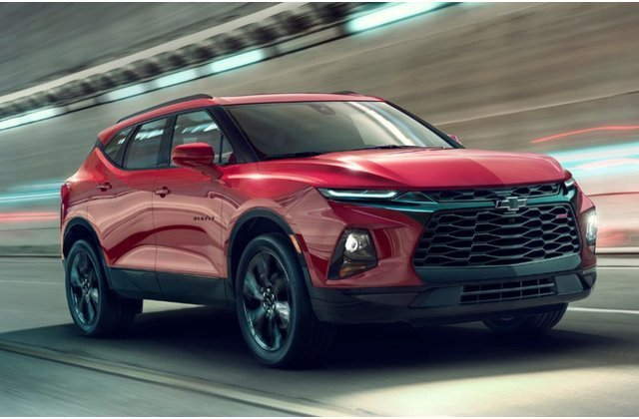
What is blazor?
Anime character?
2019 Chevrolet?

Slide 4
What is blazor really?
Removes JavaScript as the primary language you have to know for creating websites.
Allows .NET Core code to run on browsers that support WebAssembly (WASM)

Slide 5
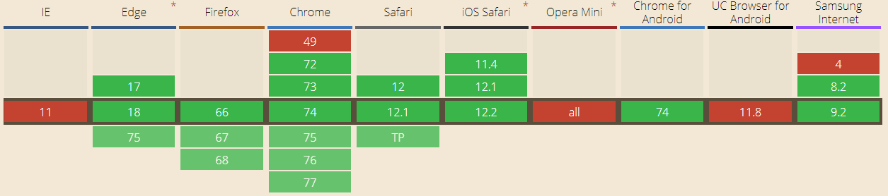
Who supports wasm?
https://caniuse.com/#feat=wasm
This represents 86% of the market and shows the top 10 browsers and their active versions
8% of global use in this group does not support WASM

Slide 6



What do you get with .net core 3.0?
Server-side
https...
ASP.NET Core
SignalR
DOM
Razor Components
.NET

Slide 7
What is coming later this year
Client-side
https://...
Razor Components
DOM
.NET
WebAssembly

Slide 8
Which of my sides looks best?
Server Side
Faster browser load times
More .NET libraries and features available
Protect you intellectual property
Client Side
Be able to run disconnected
Offloads work to browsers instead of server
If no data is needed from server, app will run faster

Slide 9

Show me some code!!!!!!
ENGAGING WARP TO CODE!!!

Slide 10
Questions?

Slide 11
Blazor The future is almost here
Robert taylor

